Slide 1

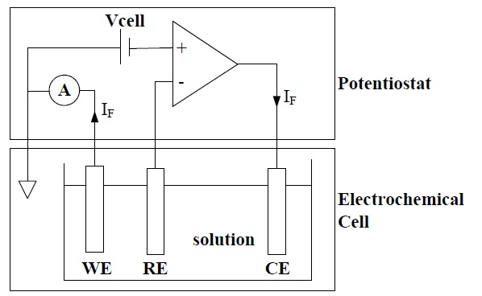
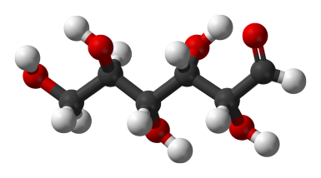

Medical Device Development and Prototyping Lab
Amperometric Biosensor
Technical Advisors:
Dr. Vitaliy Avrutin
Arthur French
Umar Hasni
Members:
Jasmine Norman
Keegan Schieve
Roxanne Jassawalla

Slide 2
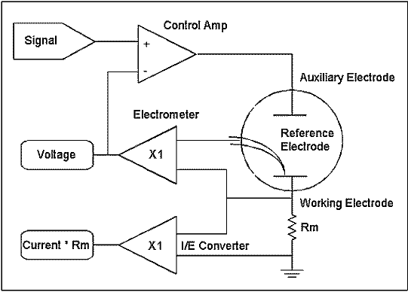

Slide 3
The Electrometer
The electrometer circuit measures the voltage difference between the reference and working electrodes. Its output has two major functions: it is the feedback signal in the potentiostat circuit, and it is the signal that is measured whenever the cell voltage is needed.
The I/E Converter
The current-to-voltage (I/E) converter in the simplified schematic measures the cell current. It forces the cell current to flow through a current-measurement resistor, R_{m}. The voltage drop across R_{m} is a measure of the cell current.
The Control Amplifier
The control amplifier is a servo amplifier. It compares the measured cell voltage with the desired voltage and drives current into the cell to force the voltages to be the same.
The Signal
The signal circuit is a computer-controlled voltage source. It is generally the output of a Digital-to-Analog (D/A) converter that converts computer-generated numbers into voltages.
http://www.gamry.com/application-notes/instrumentation/potentiostat-fundamentals/

Slide 4
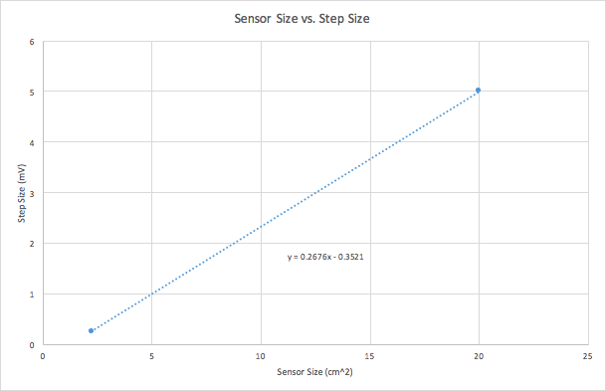
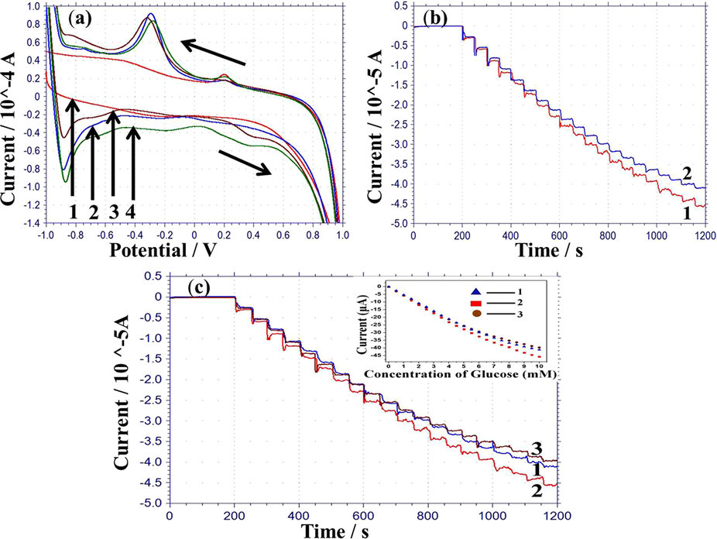
Electrode size
http://www.scielo.br/scielo.php?script=sci_arttext&pid=S0103-50532015000801632

